Slide 1
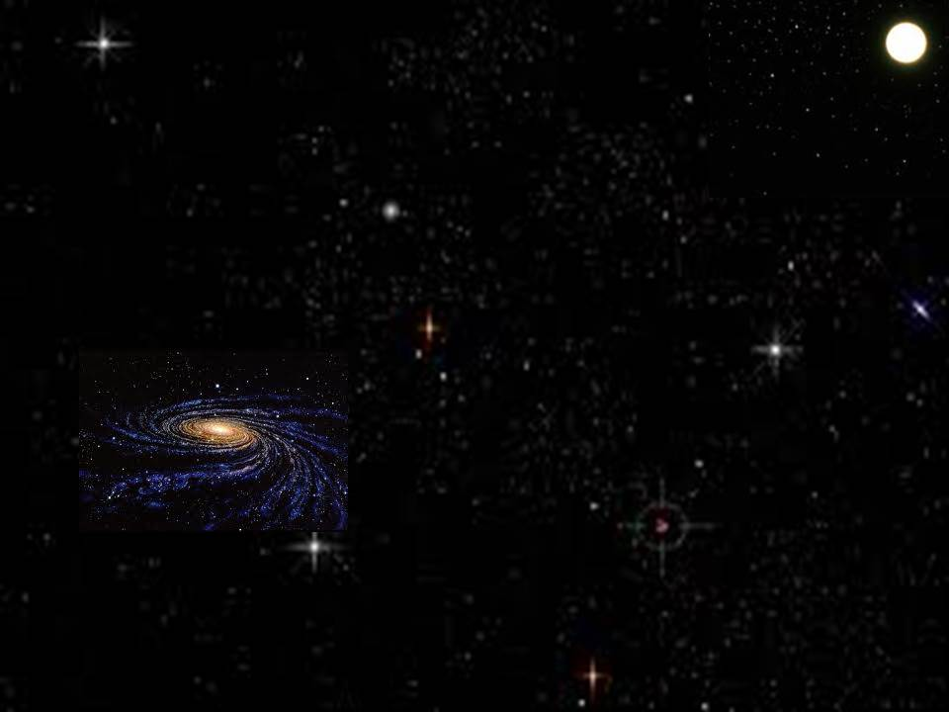
小伯利恒
Little Town of Bethlehem

Slide 2
美哉小城小伯利恆,你是何等清靜
無夢無驚深深睡著,群星悄然進行
O little town of Bethlehem, how still we see thee lie!
Above thy deep and dreamless sleep
the silent stars go by;

Slide 3
在你漆黑的街衢,永遠的光照啟
萬世希望眾生憂驚,今宵集中於你
Yet in thy dark streets shineth the everlasting Light.
The hopes and fears of all the years
are met in thee tonight.

Slide 4
For Christ is born of Mary, and
gathered all above while mortals sleep,
the angels keep their watch of wondering love.
因馬利亞誕生聖嬰,天上眾軍齊集
世界眾生酣睡正深,天軍虔敬守夜

Slide 5
O morning stars, together proclaim the holy birth,
And praises sing to God the King,
and peace to all on earth!
晨星啊,同來頌揚,同來禮拜虔誠
同來感謝至尊上主,同祝世界和平

Slide 6
宏愛上主至大恩典,普賜相信的人
何等莊嚴,何等安靜,肉耳不能聽聞
How silently, how silently the wondrous gift is given!
So God imparts to human hearts
the blessings of his heaven.

Slide 7
世界惡貫正滿盈,救主悄然降生
虔誠恭敬打開心門,救主必定降臨
No ear may hear his coming, but, in this world of sin,
where meek souls will receive him,
still the dear Christ enters in.

Slide 8
O holy Child of Bethlehem, descend to us we pray:
cast out our sins and enter in, be born in us today.
哦,伯利恆至聖嬰孩,懇求今再降臨
除我罪孽使我潔淨,安然進入我心

Slide 9
We hear the Christmas angels
the great glad tidings tell;
O come to us, abide with us, our Lord Emmanuel.
我聞天使在歌唱,宣告大喜信息
求在我心永遠長住,我主以馬內利

